Slide 1

Student Feedback Analysis using NLP and Visualisation (Google Colab). ISHALAYE OMOBOLANLE HANNAH Internship Program Tools Used: Python (Pandas, Matplotlib and NLP) Charts: Bar chart, Line chart, Pie chart, Grouped bar chart.
FUTURE INTERNS

Slide 2
Objectives of Task 3
1. Clean and prepare student feedback (Google Form export)
2. Analyse satisfaction patterns (1-5 scale)
3. Convert ratings to sentiments (Positive/Neutral/Negative)
4. Visualise trends with charts
5. Recommend improvements for future events

Slide 3
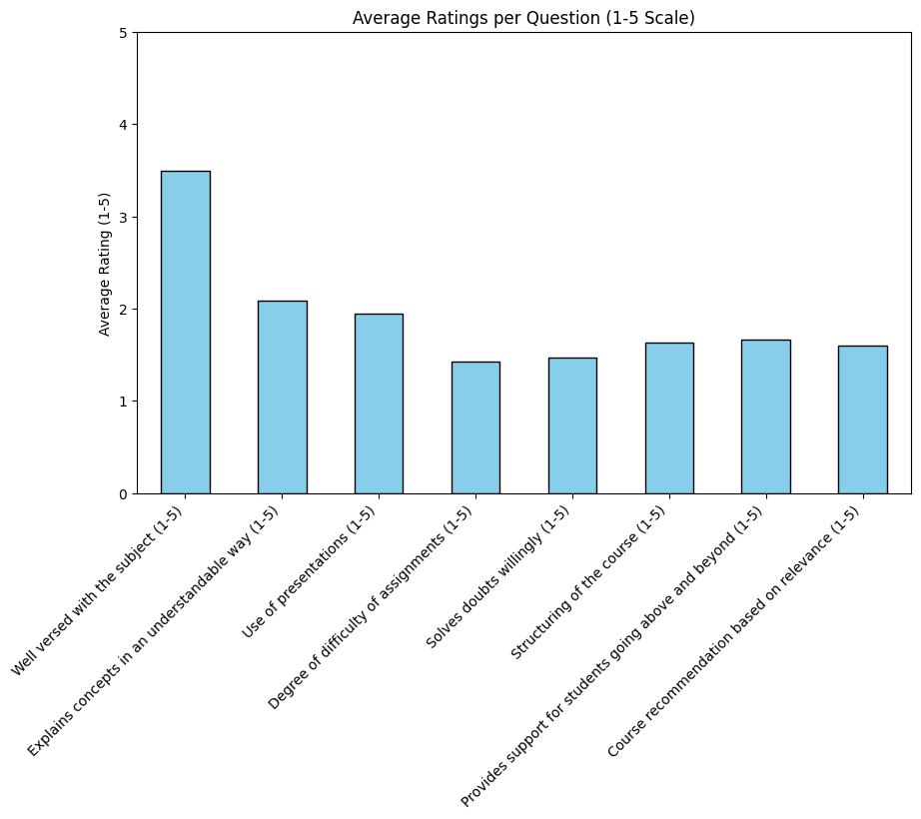

Slide 4
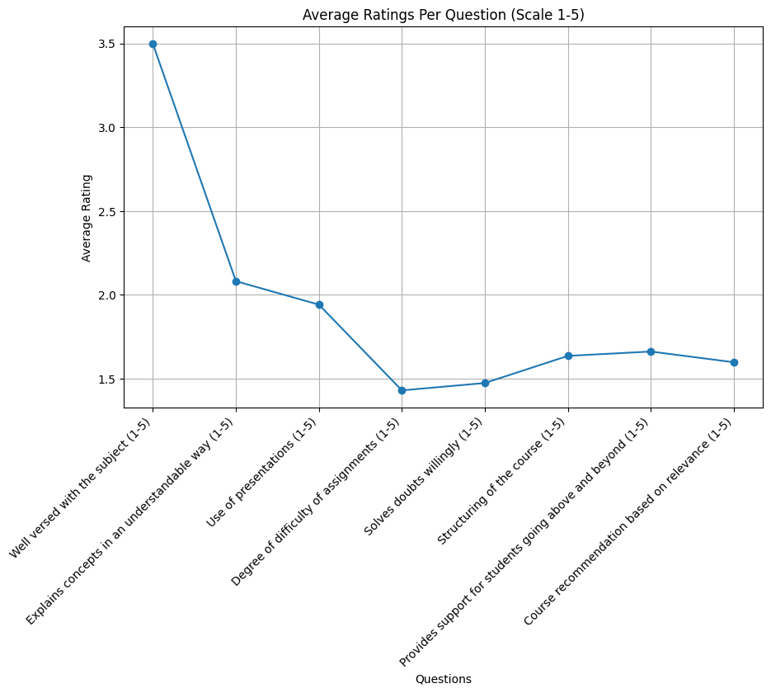

Slide 5
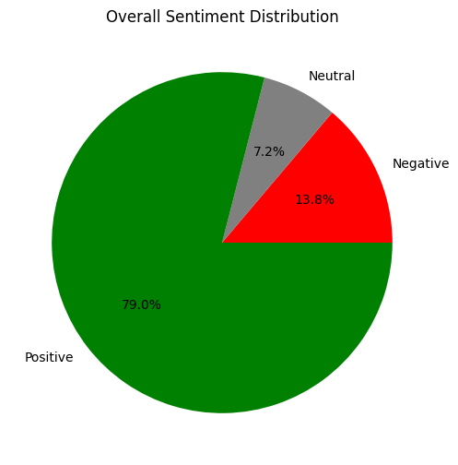
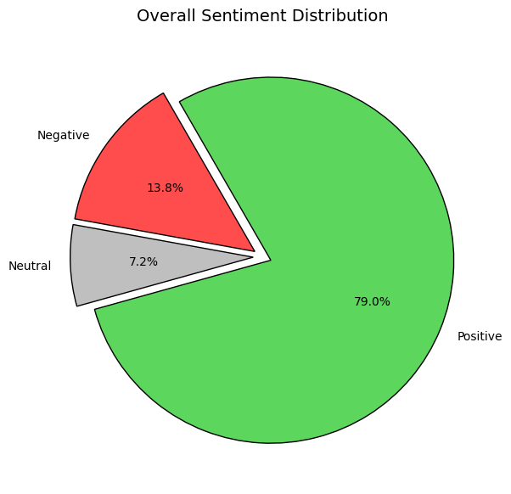
Sentiment Analysis (Pie chart) Shows the overall distribution of positive/neutral/negative.

Slide 6
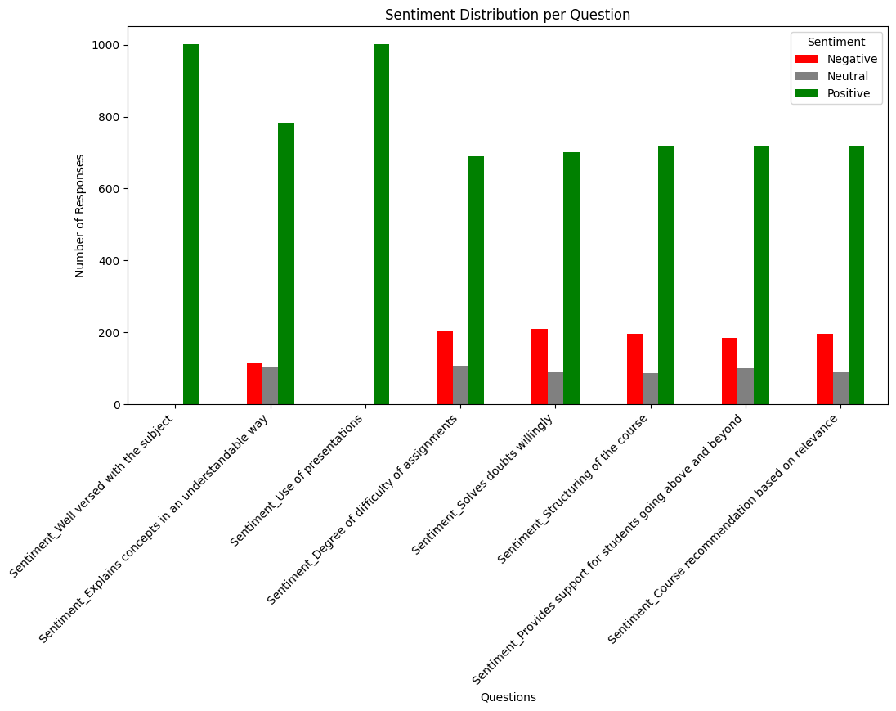

Slide 7
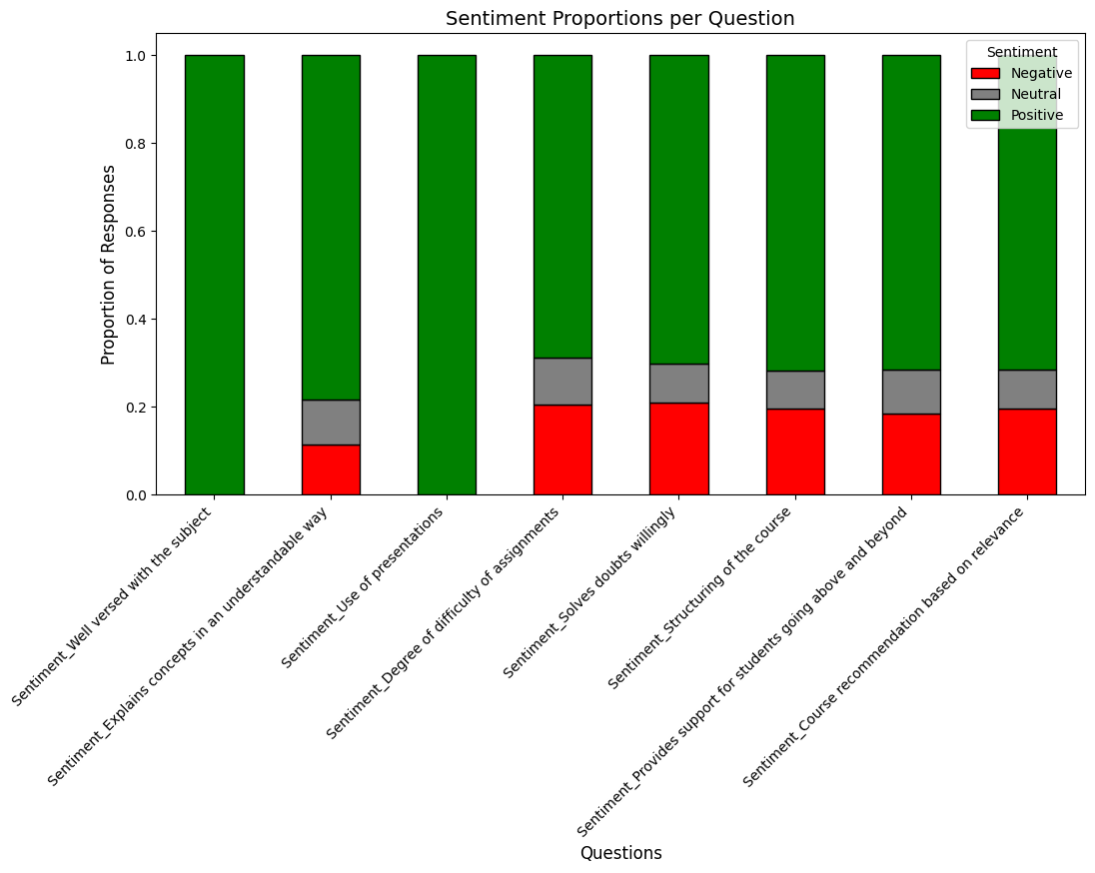

Slide 8
Recommendation for Future Events
1. Enhance Content Delivery: Ensure facilitators are well-prepared and use simple, engaging explanations.
2. Improve Engagement: Add more interactive sessions, Q&A, and hands-on activities
3. Balance Assignments & Difficulty: Keep assignments challenging but fair, with clear instructions
4. Support & Feedback: Provide regular follow-up channels for student concerns and feedback

Slide 9
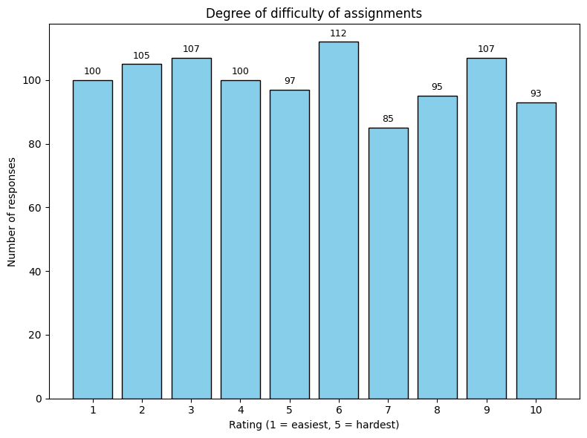

Slide 10
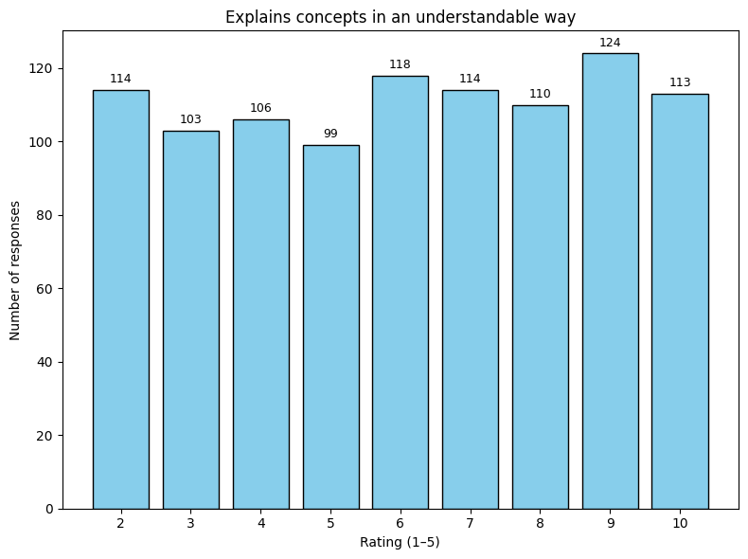

Slide 11
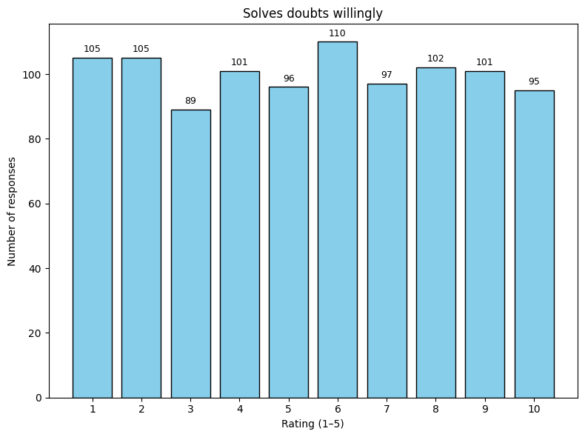

Slide 12
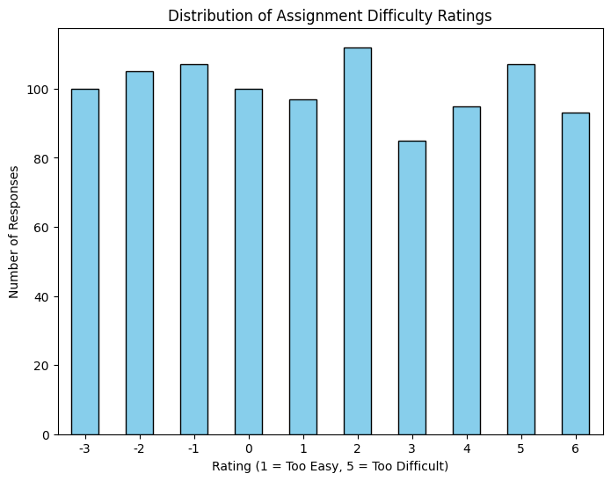

Slide 13
The analysis of average ratings per question, shown through both bar and line charts, reveals that most students rated their experience above the midpoint of the 1–5 scale, showing generally positive satisfaction.
The sentiment analysis pie chart further supports this, with a majority of responses classified as positive, though neutral and negative sentiments appear in certain areas.
The sentiment distribution per question and proportions charts highlight where challenges exist: while core teaching and presentation scored positively, assignments and support showed mixed responses, with more neutral and negative feedback.
Turning to the recommendation-focused insights, the degree of difficulty of assignments chart shows that students often found the workload challenging, pointing to the need for better pacing.
The chart on explaining concepts indicates that while most students found the content clear, a few still struggled, suggesting room for improvement in teaching methods.
The chart on solving doubts willingly reflects strong teacher support overall, but a small neutral/negative share indicates that more consistent availability could improve student experience.
Finally, the distribution of assignment difficulty ratings chart emphasises the tendency toward higher perceived difficulty, reinforcing the recommendation to balance and simplify future assignments.

